Slide 1
Lecture 16
Justice in Human-to-Human Relationship

Slide 2
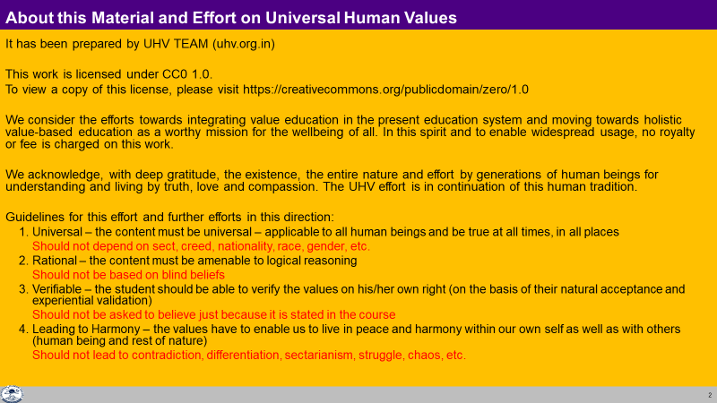

Slide 3
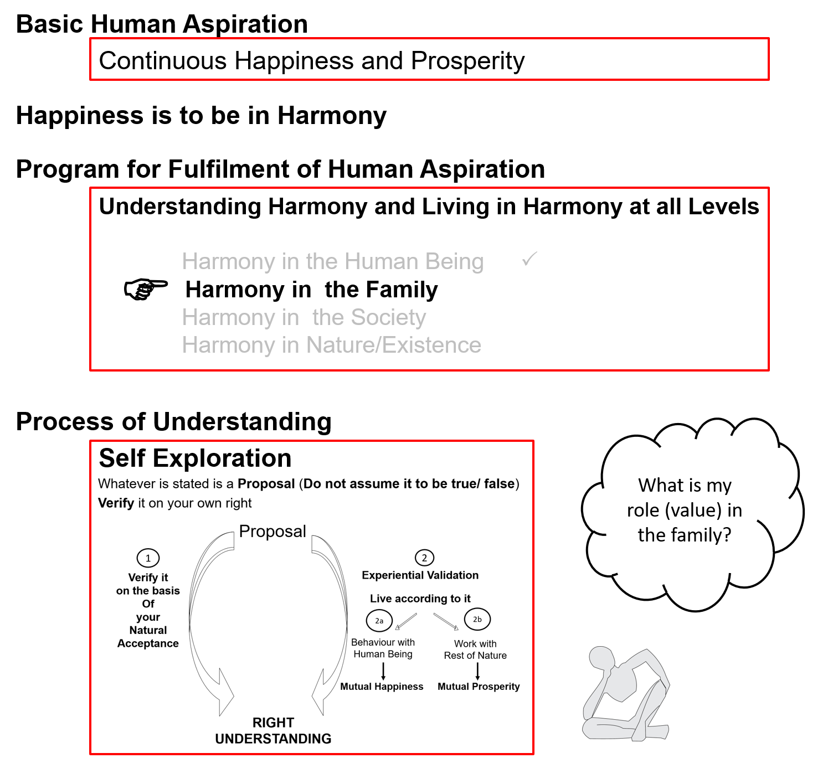
Notes:
The feelings covered in this presentation are indicated in the first slide

Slide 4
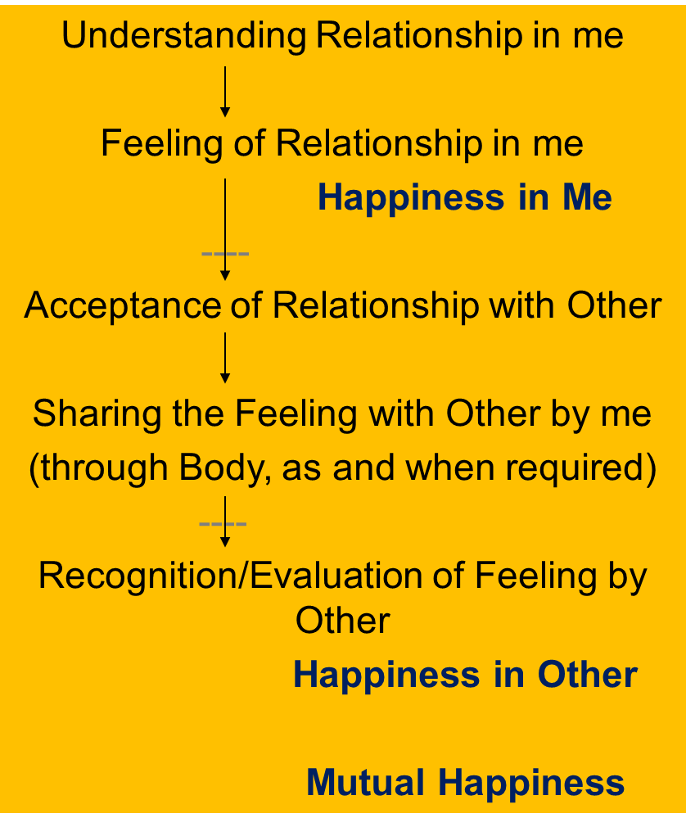
Harmony in the Family
Relationship is – between one self (I₁) and another self (I₂)
There are feelings in relationship – in one self (I₁) for the other self (I₂)
These feelings can be recognized – they are definite (9 Feelings)
Their fulfilment, evaluation leads to mutual happiness
Feelings in relationship:
1- Trust fo”okl FOUNDATION VALUE
2- Respect lEeku
3- Affection Lusg
4- Care eerk
5- Guidance okRlY;
6- Reverence J)k
7- Glory xkSjo
8- Gratitude —rKrk
9- Love izse COMPLETE VALUE

Slide 5
Affection (Lusg)
The feeling of being related to the other
(acceptance of the other as one’s relative, the other is like me)
nwljs dks laca/kh ds :i esa Lohdkjus dk HkkoA fufoZj®f/krkA
One has the responsibility and commitment for mutual fulfilment in the relationship
Opposition, jealousy... are an indication of the absence of affection
reaction (instead of responsibility)

Slide 6

Care (eerk) Guidance (okRlY;)
Feeling of responsibility toward the body of my relative
The responsibility & commitment for nurturing and protection of the Body of my relative
laca/kh ds “kjhj ds iks’k.k] laj{k.k dh LohÑfr dk HkkoA
Feeling of responsibility toward the self of my relative
The responsibility & commitment for ensuring Right Understanding and Right Feeling in the self of my relative
laca/kh dks le>nkj o ftEesnkj cukus dh LohÑfr dk HkkoA
Care & Guidance are a natural outcome of Affection
Do we ensure both care as well as guidance or are we mostly focused on care?
E.g. while taking care of the body, like while feeding the child, are we concerned about both the body as well as the self?
Notes:
6

Slide 7
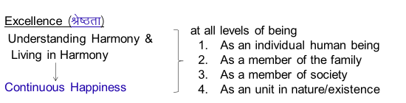
Reverence (J)k)
The feeling of acceptance for excellence
Js’Brk dh LohÑfr dk HkkoA
Excellence ¼Js’Brk½ : Completeness of Right Understanding
Working for Excellence and competing with each other are not the same thing.
In excellence, I help to bring the other up to my level
In competition, I hinder the other from reaching to my level

Slide 8
Reverence (J)k)
The feeling of acceptance for excellence
Js’Brk dh LohÑfr dk HkkoA
Excellence ¼Js’Brk½ : Completeness of Right Understanding
Understanding Harmony &
Living in Harmony
Continuous Happiness
Excellence and competition are not similar.
In excellence, one helps to bring the other to his level
In competition, he hinders the other from reaching to his level
Worship ¼iwtk½
Effort made to achieve excellence. Js’Brk ds fy, fd;k x;k iz;klA
(inspiration from the revered)
at all levels of being
  As an individual human being
  As a member of the family
  As a member of society
  As an unit in nature/existence

Slide 9
Effort for Excellence Effort for Competition
The other is like me
We are complementary
Feelings are based on right understanding
(definite, unchanging)
Feeling of relationship – unconditional
Nurtures others
Helps the other to come to his level
Absolute (definite completion point)
Not other – only me
I am different/special/more than the other
Feelings are based on preconditioning
(indefinite, keeps changing)
Feeling of opposition – relationship is conditional
Exploit others
Stops the other to come to his level - effort to accentuate the difference, to dominate, manipulate, exploit
Relative (no definite completion point)

Slide 10
Glory ¼xkSjo½ Gratitude ¼d`rKrk½
Feeling for those who have made effort for excellence
ftUgksaus Js’Brk ds fy, fd, iz;kl fd;k gS] muds izfr HkkoA
Feeling for those who have made effort for my excellence
ftUgksaus esjh Js’Brk ds fy, iz;kl fd;k gS] muds izfr HkkoA

Slide 11
Gratitude ¼d`rKrk½
Feeling for those who have made effort for my excellence
ftUgksaus esjh Js’Brk ds fy, iz;kl fd;k gS] muds izfr HkkoA
I can see that the other has a feeling of care, affection, trust.. in behaviour with me. I can also see that the other
  has helped me in developing right understanding & right feeling in me
  Has provided me with the necessary physical facility
Gratitude is significant in the development of relationship

Slide 12
Self Reflection
Check whether you have a feeling of gratitude for those who have made effort for you in your life…
1. Are you able to appreciate both –”what has been done” as well as ”what has not been done” (the complete picture)? or
are you mostly focused on “what has not been done”?
2. Do you have a feeling of gratitude for the other – continuous or
the feeing of gratitude comes and goes?
3. Are you making effort for “ensuring the right feelings in yourself and expressing them to the other” or
are you “expecting these feelings from the other”?

Slide 13
Respect, Reverence, Glory and Gratitude
Basic human aspiration = Continuous happiness
= To achieve excellence
Excellence ¼Js’Brk½
Understanding Harmony &
Living in Harmony
Continuous Happiness
Trust, Respect – For all
Reverence – For those who have achieved excellence
Glory – For those who have made effort for excellence
Gratitude – For those who have made effort for my excellence
at all 4 levels
  In the Human Being
  In Family
  In Society
  In Nature/Existence

Slide 14
Development of the Feeling of Relationship
Verify on the basis of your natural acceptance if you want to be related to:
    None
    One
    Many
    Everyone
Affection (Lusg) – The feeling of being related to the other
(acceptance of the other as one’s relative)
nwljs dks laca/kh ds :i esa Lohdkjus dk HkkoA
Love ¼izse½ – The feeling of being related to all (Complete Value)
¾ gj ,d dks laca/kh ds :i esa Lohdkjus dk HkkoA
X
→ The feeling of being related to none – in opposition to all
√
The feeling of being related to one
The feeling of being related to many
Affection
√
√
Love
→ The feeling of being related to all

Slide 15

Preconditioning Related to Love – Common misunderstandings
Excitement (from sensation, preconditioning) is confused for feeling
Sensation –
Lust, getting from the other
Continuity not possible
Preconditioning –
Infatuation
Love at First Sight?
By this age, I must have GF/BF?
The other has 4 GF/BF; I have only one?
Continuity not possible
Right understanding (natural acceptance) –
Love (प्रेम) = feeling of being related to all, responsible towards all, giving to all
Continuity
Once trust, respect, affection, care, guidance… are ensured within, then
the feeling of being related to all follows naturally
Natural Acceptance
Imagination
(in the Self)
Love
Preconditioning
Infatuation, Lust
Sensation

Slide 16
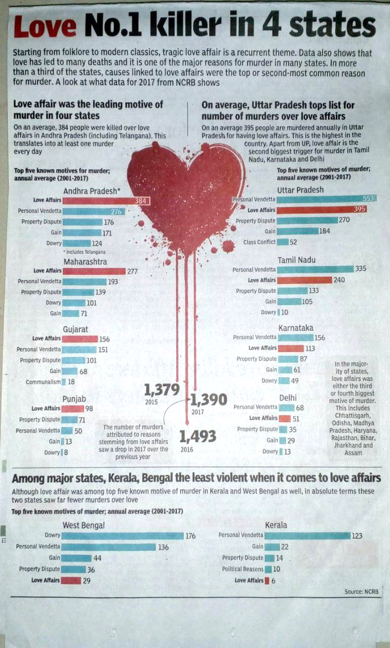
Preconditioning Related to Love
This is certainly not Love!
Do we need to understand the feeling of love?
Do the youth also need to understand the feeling of love?

Slide 17
Love ¼izse½
Love ¼izse½ – The feeling of being related to all (Complete Value)
¾ gj ,d dks laca/kh ds :i esa Lohdkjus dk HkkoA
¾ iw.kZrk esa jfr & iw.kZrk esa jr gksuk & gj ,d ds lkFk laca/k esa fufgr jl (Hkkoksa) dh vuqHkwfr djukA
It all starts with identifying that one is related to other human being (Affection - Lusg) and it slowly expands to the feeling of being related to all human beings and then to all, each & every unit in nature (human being as well as other units) (Love - izse)
,d → vusd → gj ,d dks laca/kh ds :i esa Lohdkjuk
Feeling of Love is expressed in the form of kindness (n;k), beneficience (—ik) and compassion (d#.kk). The feeling is for all, and it is expressed to those who come in contact
The feeling of Love is the foundation of Undivided Society

Slide 18
Justice
Justice is the recognition, fulfilment and evaluation of human-human relationship, leading to mutual happiness
Recognition
  Unconditionally accepting the relationship. Accepting the other with their current level of competence but aware of their full possibility (potential)
Fulfilment
  Ensuring the naturally acceptable feeling in oneself and sharing it with the other
  Living with responsibility with the other unconditionally. This makes the other comfortable and assured
  Making effort for mutual development, i.e. development of one’s own competence and being of help to the other in developing their competence
Evaluation
  Verifying that the right feeling has reached to the other and that the other is able to make out that it is the right feeling

Slide 19
Harmony in Family – Justice, From Family to World Family (Undivided Society)
Relationship is – between one self (I₁) and other self (I₂)
There are feelings in relationship – in one self (I₁) for other self (I₂)
These feelings can be recognized – they are definite (9 Feelings)
Their fulfilment, evaluation leads to mutual happiness
Feelings in relationship:
Justice = Recognition, Fulfillment & Evaluation of
Human-Human Relationship, leading to Mutual Happiness
Justice → from Family to World Family
→ Undivided Society ¼v[k.M lekt½
1- Trust fo”okl FOUNDATION VALUE
2- Respect lEeku
3- Affection Lusg
4- Care eerk
5- Guidance okRlY;
6- Reverence J)k
7- Glory xkSjo
8- Gratitude —rKrk
9- Love izse COMPLETE VALUE

Slide 20
Self Reflection

Slide 21
Self Reflection
Check whether you have a feeling of gratitude for those who have made effort for your excellence in your life…
1. Are you able to appreciate both –”what has been done” as well as ”what has not been done” (the complete picture)? or
are you mostly focused on “what has not been done”?
2. Do you have a feeling of gratitude for the other – continuous or
the feeing of gratitude comes and goes?
3. Are you making effort for “ensuring the right feelings in yourself and expressing them to the other” or
are you “expecting these feelings from the other”?

Slide 22
Self Reflection
Are you working for excellence or for being special or for domination?
Where would you draw the boundary between people who are related to you and people who are not related to you?

Slide 23
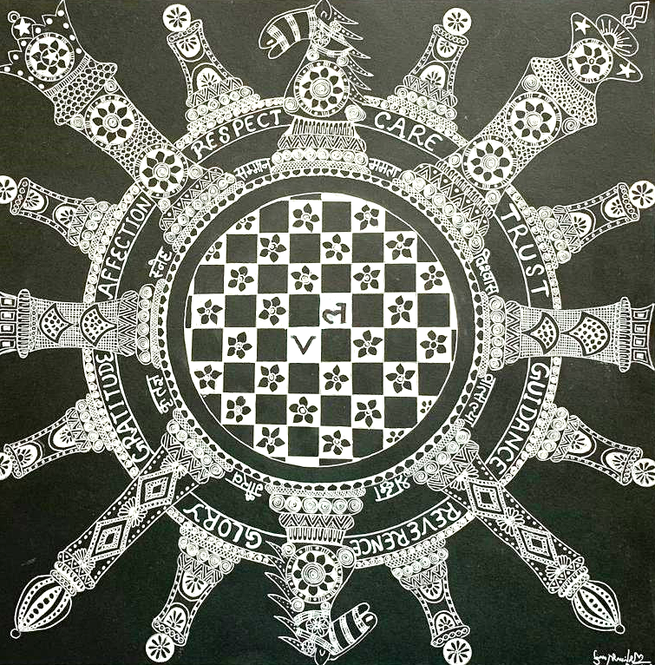

Slide 24
Assignment for Today
Each person has a different level of competence. There are many differences. But with these differences, what program can you make to ensure complementariness with every member of the family?
(Write a letter of Gratitude)
What program can you make in the institution to promote the effort for excellence in the students (and not competition)?
(In excellence, one helps to bring the other to his/her level, in competition, s(he) hinders the other from reaching to his/her level)
What efforts can be made in the institution to help the students understand the true meaning of love?

Slide 25
Self Reflection
In education, which feelings are essential in the teacher and in the student?
Make a list of people you have a feeling of gratitude.
Is love about sensation or about feeling in relationship?
What is justice? Is it to be ensured between 2 persons, then in family and so on or can it be enforced from outside?
What is the role of physical facility in understanding the right feelings and in the fulfillment of right feelings?
In relationship, where would you start?
    Expect right feelings from the other
    Take responsibility to understand relationship, ensure right feelings in yourself and express them to the other
Notes:
Eg samman purvak saada bhojan
Samay anusaar expand vishwaas (intention – competence)

Slide 26
Self Reflection
Check whether you have a feeling of gratitude for those who have made effort for your excellence in your life…
1. Are you able to appreciate both –”what has been done” as well as ”what has not been done” (the complete picture)? or
are you mostly focused on “what has not been done”?
2. Do you have a feeling of gratitude for the other – continuous or
the feeing of gratitude comes and goes?
3. Are you making effort for “ensuring the right feelings in yourself and expressing them to the other” or
are you “expecting these feelings from the other”?

Slide 27
Self Reflection
Are you working for excellence or for being special or for domination?
Where would you draw the boundary between people who are related to you and people who are not related to you?

Slide 28
Observing, Understanding Relationship, Feeling
When we pay attention to human-human relationship, the focal point is feeling, so we will pay attention to the feeling
Is the feeling that we are paying attention to
    Spontaneous or forced?
    Natural or unnatural?
    We want its continuity or not?
Has this feeling been ensured within me?
    Have I understood it? Seen it?
    Has this feeling been ensured in me or not?
    Is there continuity of this feeling in me or not?
    Explore if I have these feelings towards individual members of the family to start with, then with friends, with people we live with in the society, and ultimately with every human being
Am I able to express this feeling to the other in relationship?
Is my feeling reaching the other or not? Are they able to receive it or not? Are they able to rightly evaluate the feeling or not?
With all that, is mutual happiness taking place or not? Is mutual satisfaction being ensured or not?

Slide 29
Key Points
Lecture 16: Justice in Human-to-Human Relationship

Slide 31
Harmony in Family – Justice, From Family to World Family (Undivided Society)
Relationship is – between one self (I₁) and other self (I₂)
There are feelings in relationship – in one self (I₁) for other self (I₂)
These feelings can be recognized – they are definite (9 Feelings)
Their fulfilment, evaluation leads to mutual happiness
Feelings in relationship:
Justice = Recognition, Fulfillment & Evaluation of
Human-Human Relationship, leading to Mutual Happiness
Justice → from Family to World Family
→ Undivided Society ¼v[k.M lekt½
1- Trust fo”okl FOUNDATION VALUE
2- Respect lEeku
3- Affection Lusg
4- Care eerk
5- Guidance okRlY;
6- Reverence J)k
7- Glory xkSjo
8- Gratitude —rKrk
9- Love izse COMPLETE VALUE

Slide 32
Feelings in Relationship: Expression of Truth, Love and Compassion
Trust fo”okl I am assured that the other intends my happiness & prosperity. The other is similar to me.
I have a feeling of being related to the other
Foundation Value vk/kkj ewY;
Respect lEeku Right evaluation. We can make effort together.
We are complementary to each other.
Affection Lusg Acceptance of the other as one’s relative
Care eerk Responsibility & commitment for nurturing and protecting the body of one’s relative
Guidance okRlY; Responsibility & commitment for ensuring Right Understanding and Right Feeling
in the self of one’s relative
Reverence J)k Acceptance for Excellence
Glory xkSjo Acceptance for those who have made effort for Excellence
Gratitude —rKrk Acceptance for those who have made effort for my Excellence
Love izse The feeling of being related to all
Complete Value iw.kZ ewY;

Slide 34
FAQs for Lecture 16
Justice in Human-to-Human Relationship

Slide 35
Question(s): Response
Isn’t affection the same as attachment to one or few people?
How would we recognise that someone has a feeling of affection for us? Could you give us some indicators of affection?
Affection is the feeling of being related to the other. Attachment, however, indicates that we have over-evaluated the relationship and we have become dependent on the other for our happiness. Affection is born out of my understanding of relationship and this makes us self-dependent and having commitment for the other.
When we have feeling of affection for someone, we have the commitment for the fulfillment towards him. This commitment shows up in the form being responsible towards the wellbeing of the relative, both at the level of self as well as body. So, we work for ensuring right understanding and feeling in the self (guidance) and for ensuring the health of the body (care) of my relative.

Slide 36
Question(s): Response
You are saying lack of affection is jealousy but I find that there are some people for whom I don’t have a feeling of affection, but I am not jealous of them either. What would you call this?
What is the difference between affection and love
You want to say that you are being indifferent. Are you seeing this at the level of feeling or at the level of its fulfillment. At the level of its fulfillment, you may not be doing it with many people, even those for whom you have feeling of affection, but, at the level of feeling, it is important whether you have the feeling of affection or not. If you have the feeling of affection, it leads to harmony and happiness within, if not it leads lack of harmony, lack of happiness, somewhere deep down you have the feeling of fear with him. Observe this.
Affection is the feeling of being related to one or many, while, love is the feeling of being related to all.

Slide 37
Question(s): Response
When I am feeding my child, I realise I am paying more attention to the body, but then this is necessary to keep the child healthy – he does not know what is good for him, how much is required etc.
We also care about other people’s feeings. Is that not care? What would you call that?
This is fine. But, we have to make sure that we are talking of the self also, atleast not violating it. For example, when we are force feeding the child, are we taking care of the self also or violating it?
In the general use of the word ‘care’, it is so. But, here, we have defined the feeling of care as feeling of responsibility towards body. Taking care about other people’s feelings can be called as expression of feeling of affection.

Slide 38
Question(s): Response
Is there any difference between being a good teacher in a particular subject and guidance?
Guidance as defined here, has to do taking the responsibility of development of the self. This means ensuring right understanding and right feelings in the self of the relative. This is very broad and teaching a subject may be a part of it.

Slide 39
Question(s): Response
Can we not achieve excellence through competition? After all good colleges and good jobs are so limited, so there has to be competition
I can understand what you said about competition. But to grow, should there not even be healthy competition? Or at least competing with myself?
Without competition what would be the motivation for innovation and growth?
For excellence, we have to ensure understanding of harmony and living in harmony at all levels of our being. For this we don’t have to compete, there is provision for everyone to do this in this nature, in existence. We only have to develop a proper system of education which will make it available to all.
To grow, we have to work for excellence, and in the process we cooperate and not compete. When you say ‘competing with myself’, it would essentially mean working for excellence.
Motivation for innovation and growth comes from working for excellence, as mentioned above.

Slide 40
Question(s): Response
We seek “name and fame” like movie actors or sports persons. Should we not have feeling of glory for such people?
Can one have glory for oneself? Is glory same as pride?
Where would national pride fit in with these feelings?
If they are working for excellence, then yes; if not, you ask your natural acceptance.
We can have. If pride has a sense of ego, then it is not same as glory, if not then, we can call it self-pride.
A society or a nation which is working for excellence, we will have a feeling of glory for it, and if it does not include ego, we can call it pride.

Slide 41
Question(s): Response
Is gratitude the same as being thankful to someone or for something?
Our students seem to be grateful for some time but then they tend to forget about it. Even our own children, we do so much for them, but there are times when they are so ungrateful. How to make them feel this gratitude?
Gratitude is the feeling for any help that we have received for our self development. This would include being thankful to someone or for something
If we are giving them something which has continuity, then they will have the the feeling of gratitude in continuity. Ultimately, we have help them ensure right understanding and right feeling in them and then they will have continuity of feeling of gratitude.

Slide 42
Question(s): Response
Love, falling in love, having boy/girl friends is a major issue for my students. It often distracts them from studies. How can that be resolved?
Do we still have the feeling of affection when we have the feeling of love?
Can you explain the feeling of love in more detail, as there are many confusions related to this.
They have to understand the feeling of love, atleast feeling of affection and see that it is related to the self and not to the body. Then they will be able to be responsible towards themselves (including their studies) and others.
Feeling of affection is contained in the feeling of love.

Slide 43
Preconditioning Related to Love – Common misunderstandings
Excitement (from sensation, preconditioning) is confused for feeling
Sensation –
Lust, getting from the other
Continuity not possible
Preconditioning –
Infatuation
Love at First Sight?
By this age, I must have GF/BF?
The other has 4 GF/BF; I have only one?
Continuity not possible
Right understanding (natural acceptance) –
Love (प्रेम) = feeling of being related to all, responsible towards all, giving to all
Continuity
Once trust, respect, affection, care, guidance… are ensured within, then
the feeling of being related to all follows naturally
Natural Acceptance
Imagination
(in the Self)
Love
Preconditioning
Infatuation, Lust
Sensation

Slide 44
Preconditioning Related to Love
This is certainly not Love!
The feeling of love needs to be understood rightly by all,
particularly by youth

Slide 45
Love Infatuation
Happiness = Right understanding & right feeling in the self
Love = feeling in the Self
Based on relating to the other self unconditionally
Continuity is possible
Happiness = sensation (through the body) & feeling from other
Love = sensation
Infatuation, Attraction, Liking, Lust, Vasna, based on getting sensation / feeling from the other
Continuity is not possible

Slide 46
Question(s): Response
What is the difference between ragging and interaction?

Slide 47
Ragging Interaction
When we are not able to see this relationship with the newcomers, then we may tease them, make fun of them just for the sake of fun. We are not concerned about its impact on the newcomer. Of course, it hurts others. That is ragging.
Can you recall, how does it feel, when you are hurt by someone? For how many days/ months/ years, it disturbed you?
Is it wise/ a normal mental status to seek enjoyment by hurting others?
How do you feel when a relative/ friend come to your family?
We feel happy about it. We want to share many things with them and also listen from them. This exchange of feelings and words satisfy all of us. That is interaction
(Here, we feel concerned with them, take care of their immediate needs and facilitate them to set their things in order….)

Slide 48
Interaction and Ragging
Of course, a welcoming healthy interaction is a must, because we are a member of the same institute family, will be staying together for 3-4 years
Thus, we are related to each other, we want to know each other so that we can be of help for each other in the process of understanding and learning together

Slide 49
Question(s): Response
What is the difference between feeling and expression of feeling?

Slide 50
Feeling and Expression of Feeling
Feeling Can be continuous
Continuity is desirable for right feelings
e.g. Respect
Expression of Feeling Can’t be continuous
We don’t want continuity here!
e.g. Shaking hands
Feeling Expression of Feeling _______
Trust Cooperation
free from complaints, irritation, anger
Respect Mutual development
Affection Commitment- responsibility towards relative
…
Love Compassion, Unconditional commitment
free from struggle
The important thing is to understand the feelings, to ensure the feelings within

Slide 51
Competition and Collaboration/Cooperation
What is the difference between Competition and Collaboration/Cooperation
When we feel related to each other, we cooperate. On the other hand, when have a feeling of opposition, we compete.
Our natural acceptance is for relationship and cooperation and not for opposition
In today’s world view, we assume there is “Struggle for survival and survival of the fittest”; rather than a relationship of mutual fulfillment in nature.
Just ask yourself- When does our mutual growth/ competence becomes better-
  When we help each other wherever needed
  When we work separately in isolation or
  When we work separately in opposition

Slide 53
Right Feeling Within Feeling from Other
You have the right understanding
(of relationship, harmony and co-existence)
[You are aware of it, guided by it]
This ensures
You have the right feeling within
(happiness)
definite, continuous, unconditional
(Right understanding and right feeling is your property;
not dependent on other;
You are in a state of self-organisation or swatantrata)
Within, you don’t have any definite feeling (it keeps fluctuating)
If the other expresses right feeling, you feel “happy”
If the other expresses wrong feeling, you feel “unhappy”
This indicates
You don’t have the right understanding
(In terms of feeling, you are dependent on the other;
you are in a state of enslavement or partantrata)

Slide 54
The expression of feeling is only an indicator of the state of being
The other is not expressing the right feeling
The other does not have the right feeling
(is unhappy)
The other does not have the right understanding
+
The other has a natural acceptance to make you happy and prosperous
[but (s)he is not aware of it, is not guided by it]
You are not perturbed by it
Check own past misbehaviour
You express right feeling only, try to assure the other
You are committed to help the other develop right understanding (as and when (s)he feels assured of you, your behaviour)
You have trust on intention of the other. You feel related to the other. You feel responsible in the relationship, unconditionally

Slide 55
Role of Physical Facility in Fulfilment of Relationship
Physical facility is only useful for nurturing the body, its protection and its right utilisation
Of course, it includes using the body for fulfilment in relationship
In the expression of the feelings
In that context, only for fulfilling the feeling of care there is a role of physical facility (for nurturing, protection and right utilisation of the body)

Slide 56
Family
People living together in a relationship of mutual fulfillment with a common family goal (happiness, prosperity → continuity)
Family is a training ground:
  To understand relationship & to live in relationship
  Developing the right feeling (trust, respect… love) → happiness
  2. To understand the need of physical facility & together produce more than required physical facility → prosperity
  3. To participate in the larger order (in the family… in the society) → continuity of happiness, prosperity… generation after generation

Slide 57
Competition and Collaboration/Cooperation
When we oppose/ misguide each other
Wrong impacts of feeling of competition-
On our own happiness and prosperity
On other human beings with whom we are interacting
On the society and nature
We feel unhappy, whenever we have a feeling of competition within
Hinders the growth of others and make them unhappy
Promotes struggle, war etc in the society
Over-consumption and therefore exploitation of natural resources
When we feel related to each other, we cooperate. On the other hand, when have a feeling of opposition, we compete.
Our natural acceptance is for relationship and cooperation and not for opposition
Our perception depends upon our world-view
In today’s world view, we assume there is “Struggle for survival and survival of the fittest”; rather than a relationship of mutual fulfillment in nature.
Just ask yourself- When does our mutual growth/ competence becomes better-
  When we help each other wherever needed
  When we work separately in isolation or
  When we work separately in opposition

Slide 58
आप प्रेम की बात कर रहे हैं और हमारे पड़ोसी देश हमारे देश पर आए दिन हमला बोलते रहते हैं, हमें गुलाम बनाने की तयारी करते रहते हैं | अगर आपकी बात मान लें तो इसका मतलब तो फिर बार्डर से army भी हटा देनी चाहिए | तो ऐसा लगता है के आप के काल्पनिक बात कर रहे हैं|
अगर आज समाज की स्थिति की बात करें तो लगभग-लगभग पूरी धरती के संसाधनों को चंद हाथों ने कंट्रोल कर लिया है | ऐसे में एक शिक्षक जो ईमानदारी से अपने बच्चों का पालन-पोषण कर रहा है, वो क्या कर सकता है|

Slide 59
How about other feelings like truth, honesty, hard work, integrity, sympathy, empathy… These are also valueable. Can we call these also values?

Slide 60
Question(s): Response
Had it not been for disciplinary committees and anti-ragging enforcement, we would have had lot of ragging on our campus. Do you think justice can be managed without strict enforcement?
Today we go to court for justice. What would be the role of courts in serving justice?
What is the role of punishment and atonement (prayaschit) in justice?

